Slide 1
Beginner Guide to Power BI
Ahmad Hatahet, Nov 19th, 2022

Slide 2
Import and Transform Data:
Import CSV
Simple Date transformation
Region/Localization
Replace Values
How steps are listed and could be renamed
Add Custom Column
Merge Queries
Append Queries
Pivot/Unpivot Columns

Slide 3
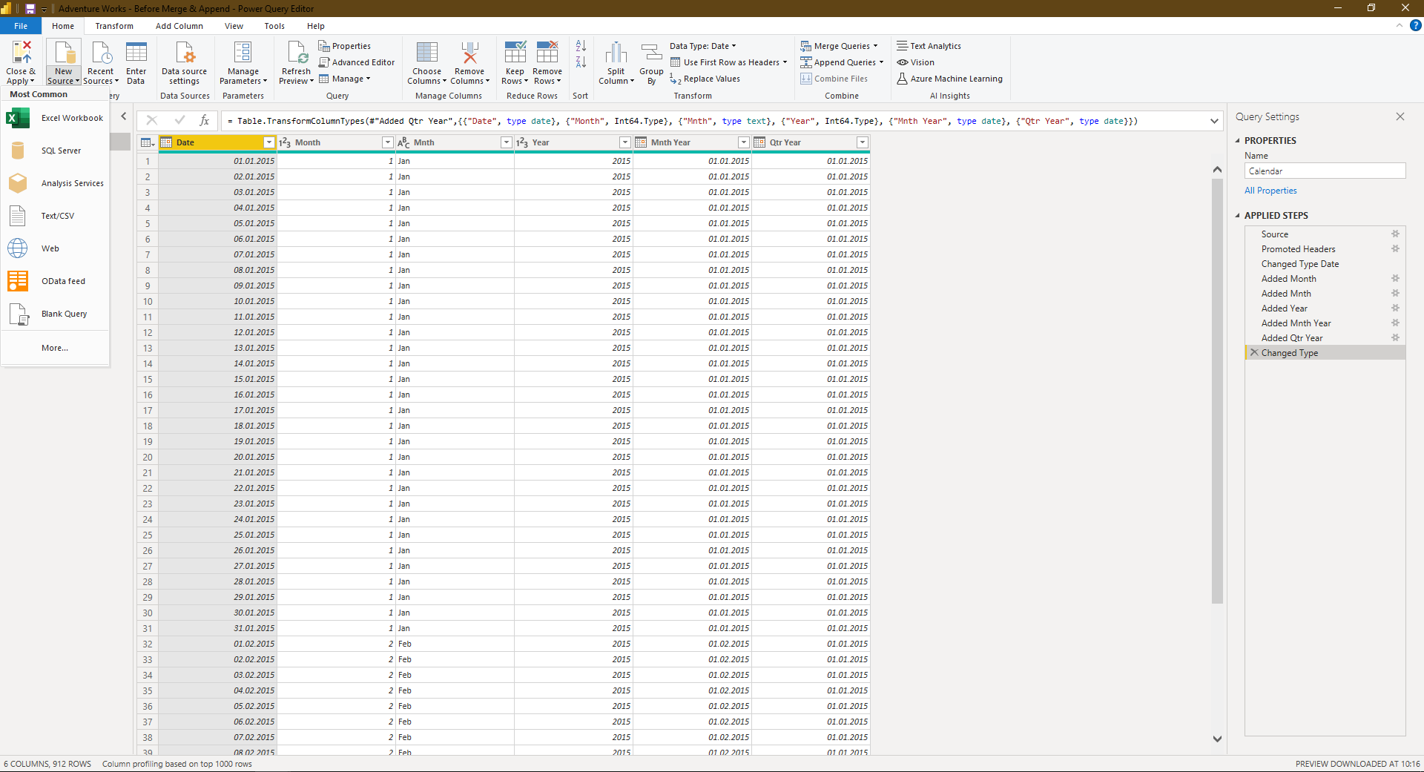
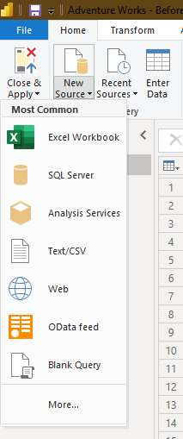
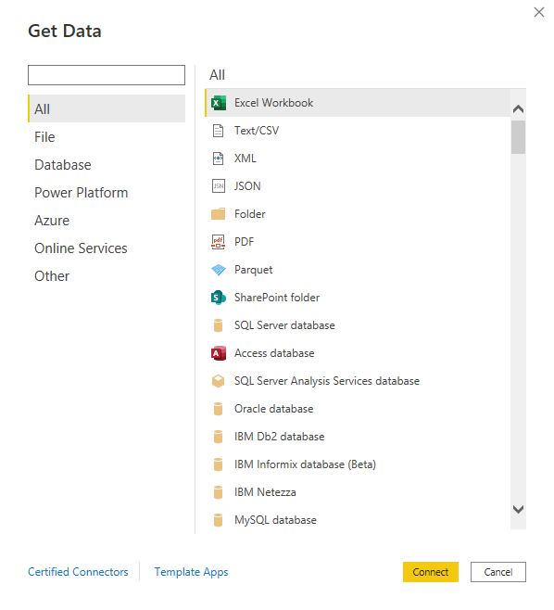
Import CSV
All files in a folder
Excel and simple text files
Connect to SSMS

Slide 4
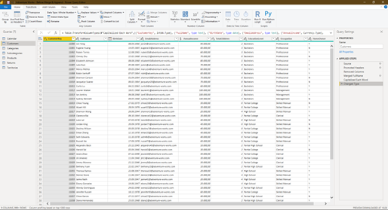
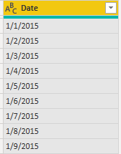
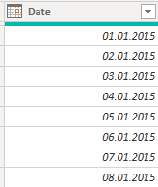
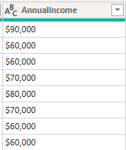
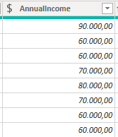
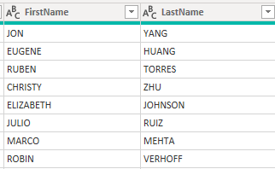
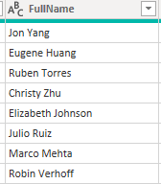
Simple Date transformation
Text to Date
Text to Currency
Merge Columns

Slide 5
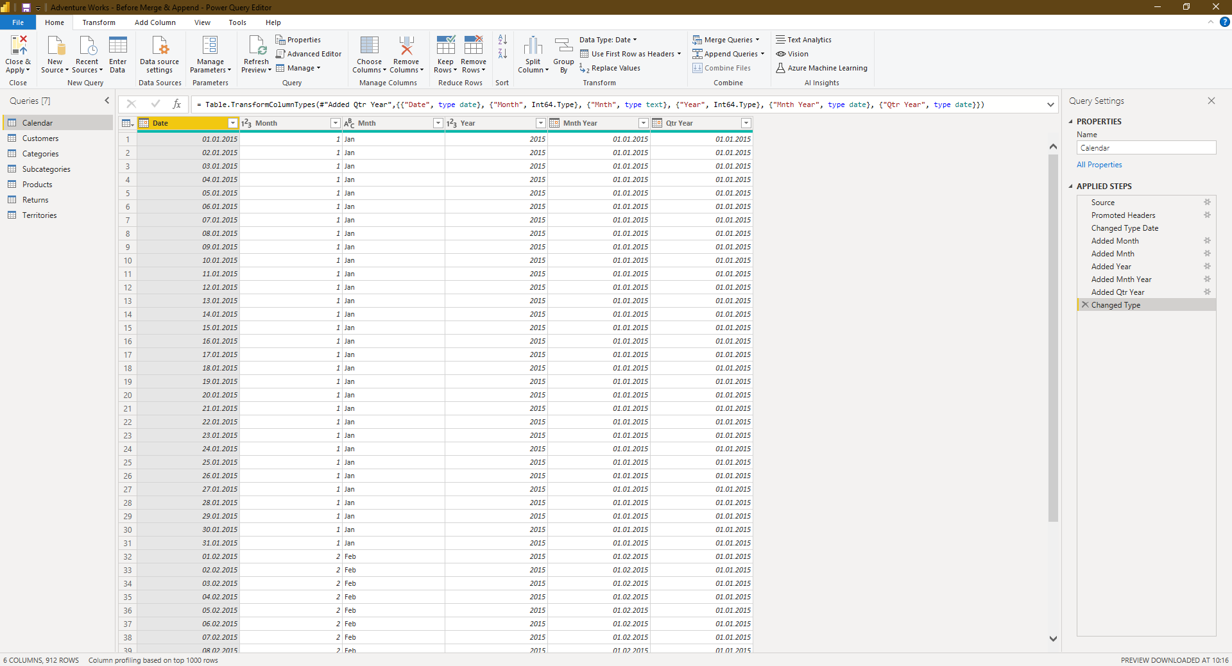
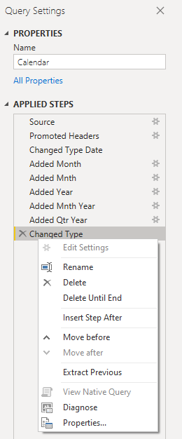
Query Steps
Query Name
Query Steps
Executed in sequential order
Edit custom column function
Rename a step
Rename a step
Delete a step

Slide 6
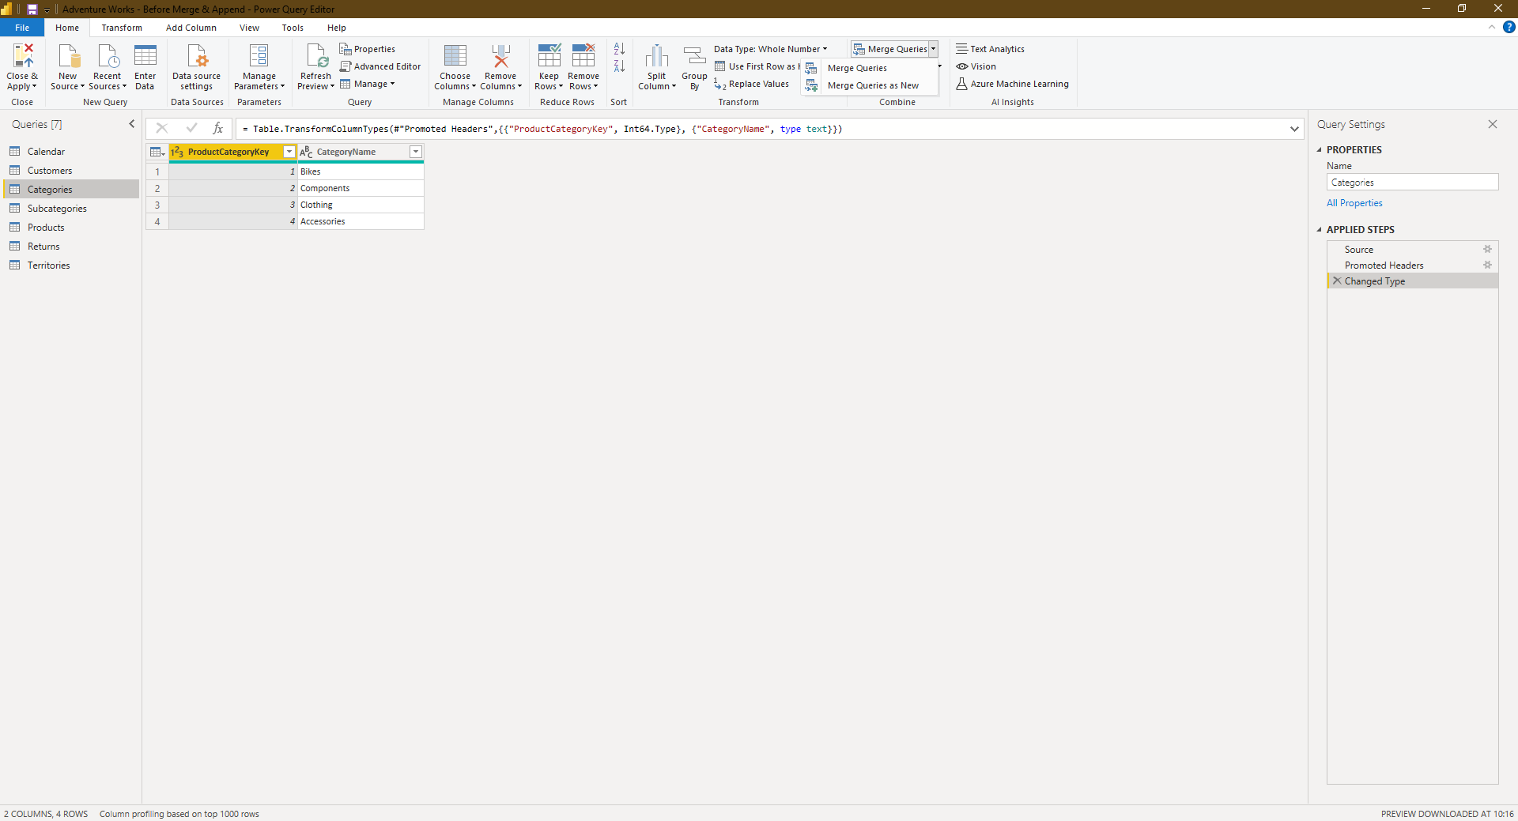
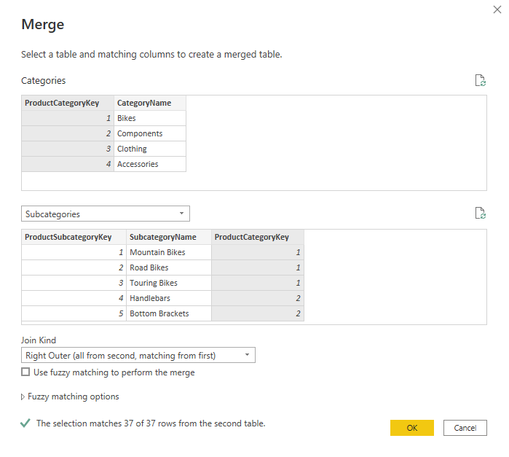
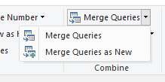
Merge Queries
Left Table
Right Table
Join Type

Slide 7
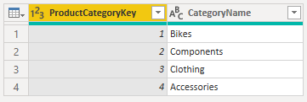
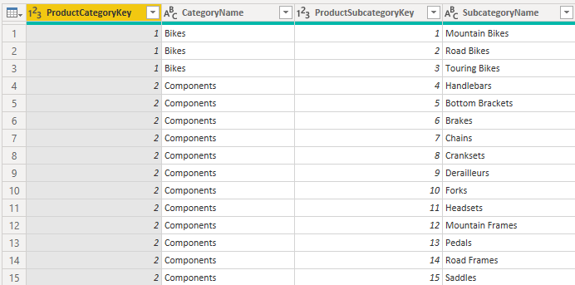
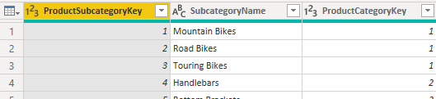
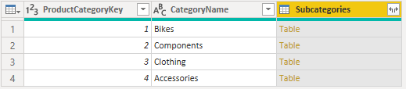
Merge Queries
Repeated at each occurrence

Slide 8
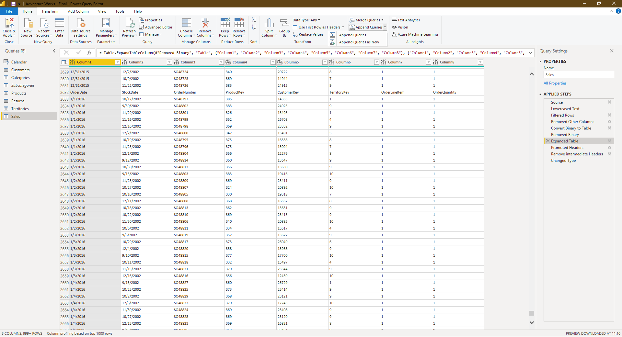
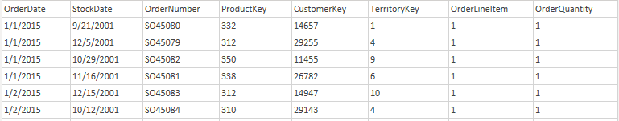
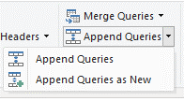
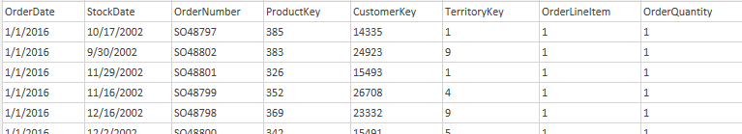
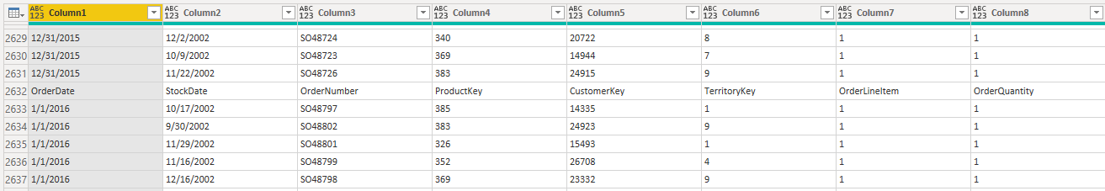
Append Queries
Import from folder, automatically append all imported files

Slide 9
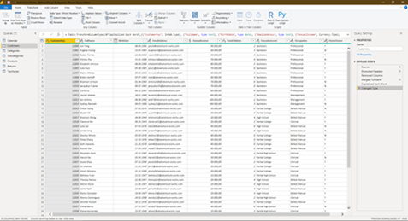
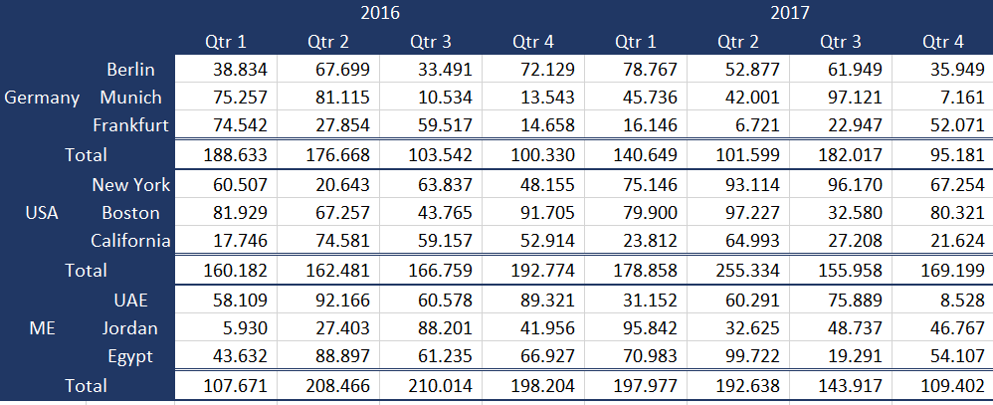
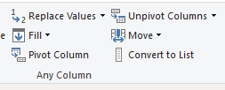
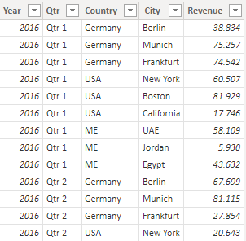
Pivot/Unpivot Columns

Slide 10
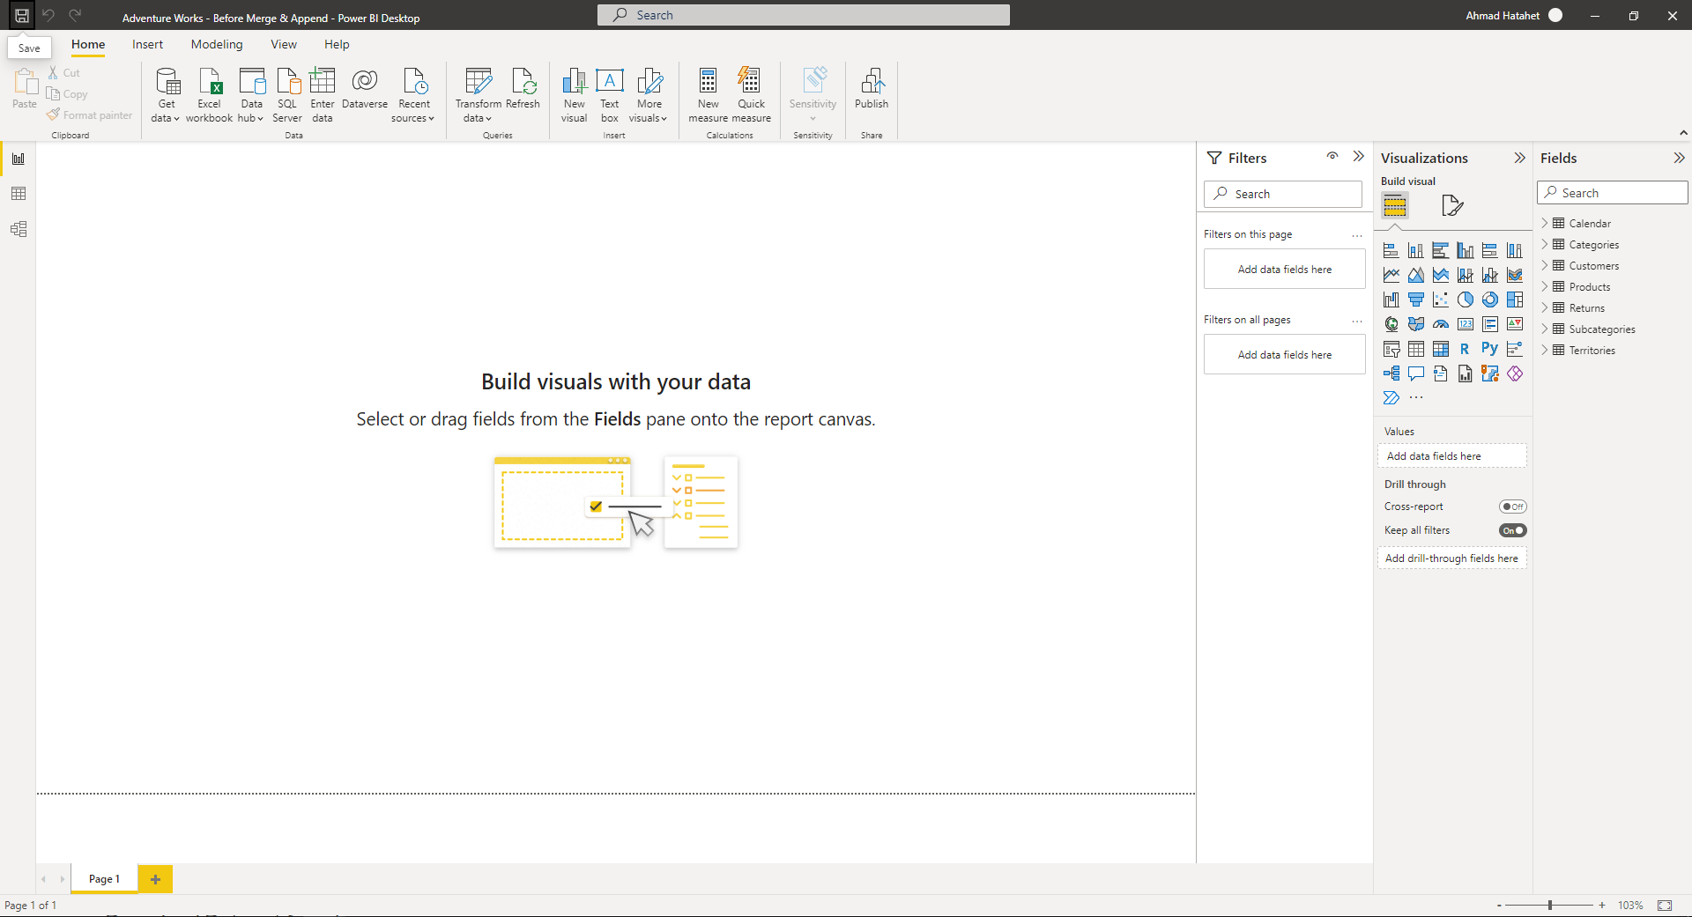
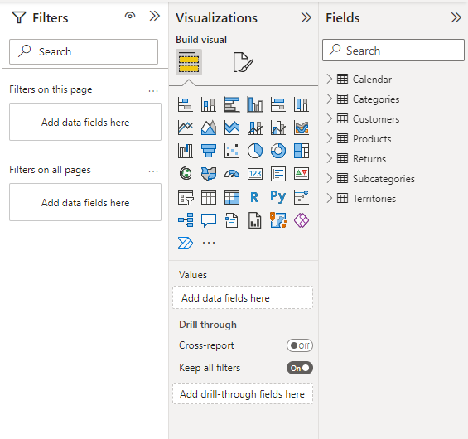

Power BI GUI:
Report View
Fields
Visualizations
Filters
Table View
Relationship
One to Many
Direction of the relation

Slide 11
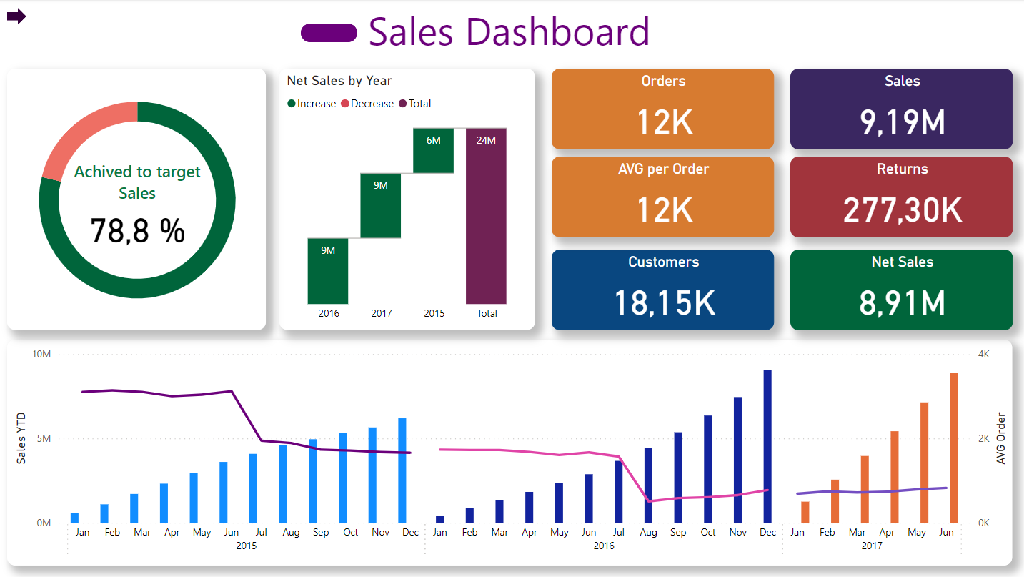
Starter Dashboard:
Sort Month Names based on numbers
Add Slicer
Add Line
Data Labels
Legends
Add Matrix
Order of fields
Add KPI

Slide 12
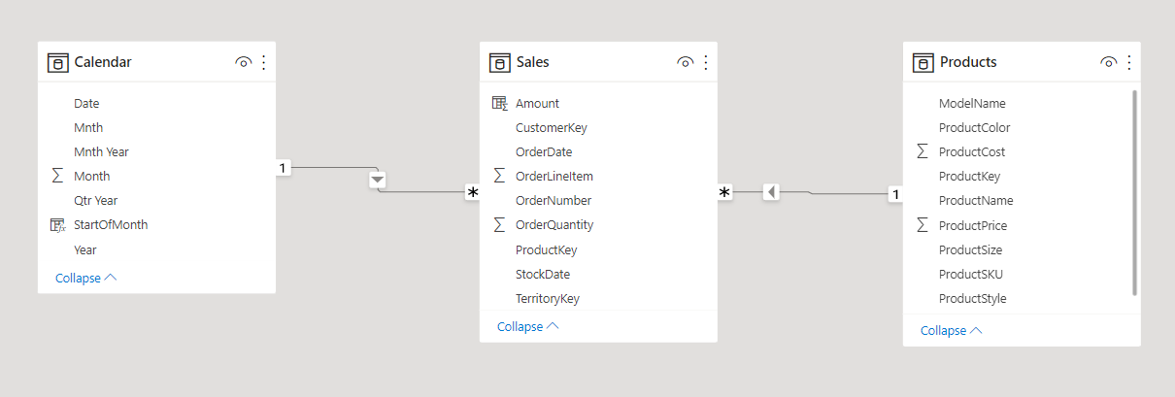
Relationship
One fact table and multiple dimension tables “Star Schema”
Left table “Calendar” can slice right table “Sales”
Each Product has multiple sales

Slide 13
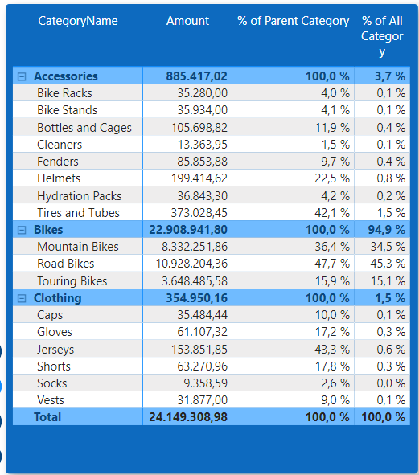
Writing DAX
Measure
Filter Context
Collect all measures in one place
Iterate (SUMX, AVGX)
Calculate – Override filter context
Calculated Column vs Measure

Slide 14
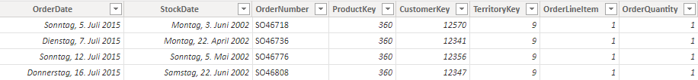
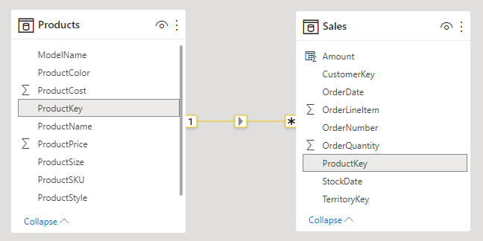
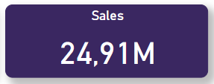
Iterate (SUMX, AVGX)
1
How to get total sales? SUM(Quantity * Price)
2
We have quantity, but not the price?
3
Add a measure to get the price and multiply with the quantity for each row in “SALES”
Use “RELATED” to fetch the prices, by utilizing the relationship between “SALES” and “PRODUCT”
Amount =
SUMX (
Sales,
RELATED(Products[ProductPrice]) * Sales[OrderQuantity]
)

Slide 15
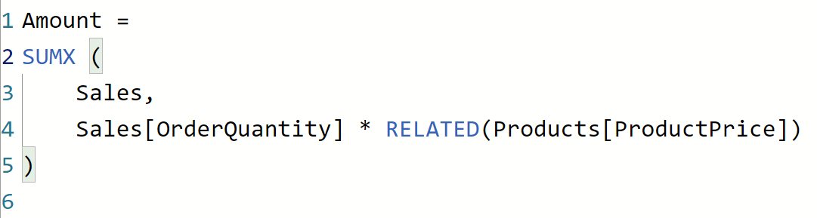
Syntax - SUMX
Measure or Column Name
Table name to iterate over
Expression to be applied for each row
The aggregation to do after finishing iterating

Slide 16
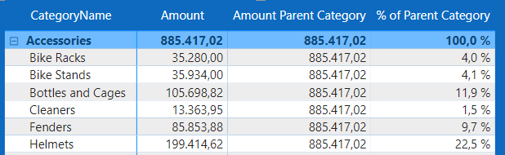
Calculate – Override filter context
1
What is the Product importance within his category?
Calculate the product sales
Total sales for each category
Divide the product sales by the
2
3
4

Slide 17

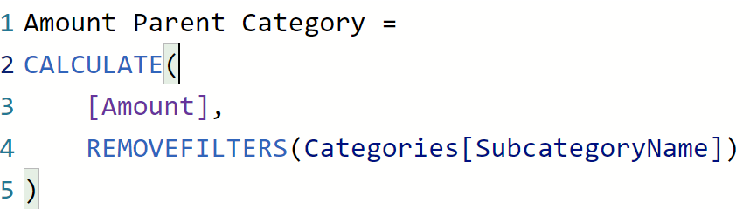

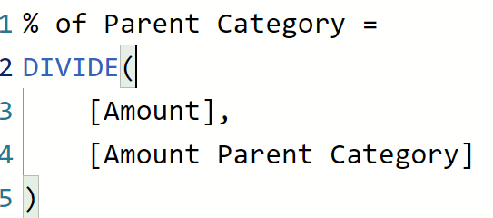
Syntax - CALCULATE
Calculate the product sales
Total sales for each category
Translation: calculate the [Amount] but ignore all filters regarding “SubcategoryName”
Overwrite Filter
Divide the product sales by the

Slide 18
Calculated Column vs Measure
Calculated Column:
Saved with the model
Calculated at refresh time
Row Context
Measure:
Only definition is saved
Calculated when it is used
Map
Abuse usage of the numbers
I can afford the extra storage
I don’t have extra computing power
Calculated Column
Default
Otherwise
Measure
More detailed comparison

Slide 19
What is Next:
Advanced DAX
Summarize, RANKX, SWITCH, Conditional Formatting
Drill through
Bookmarks
Navigation menu
DAX Studio
Analyze generated DAX queries (Formula Engine vs Storage Engine)
Tabular Editor
Calculation Groups

Slide 20






Important References
Link to Dataset “Adventure Works” on Kaggle

Slide 21
Thank you for your patience

